Slide 1

Welcome to Teacher.io
Teacher.io is an AI-powered learning platform that makes programming education engaging, personalized, and accessible to aspiring coders of all levels. Our mission is to empower the next generation of developers through innovative learning experiences.
se
by snake eyes

Slide 2

Challenges in Learning Programming
1
Lack of Guidance
2
Overwhelming Curriculum
Programming can be an intimidating subject, especially for beginners who struggle to find the right learning resources and plan their educational journey.
The sheer breadth of programming languages, frameworks, and concepts can be overwhelming, making it difficult for students to prioritize and master the fundamentals.
3
Limited Feedback
Without personalized guidance and feedback, students often feel lost, unable to assess their progress, and struggle to improve their coding skills.

Slide 3



How Teacher.io Solves These Problems
Personalized Roadmaps
AI-Powered Support
Interactive Lessons
Our AI-powered platform creates custom learning paths based on each student's goals, skill level, and learning style.
Serena, our virtual assistant, provides personalized guidance, feedback, and motivation to help students overcome challenges.
Our engaging, hands-on lessons combine theory, practice, and real-world projects to reinforce learning and keep students motivated.

Slide 4

Personalized Programming Roadmaps
1
Skill Assessment
Our AI-powered assessment evaluates a student's current knowledge and identifies their strengths and weaknesses.
2
Personalized Curriculum
Based on the assessment, we create a customized learning plan that addresses the student's specific needs and goals.
3
Adaptive Learning
The roadmap adjusts in real-time, helping students stay on track and move at their own pace.

Slide 5
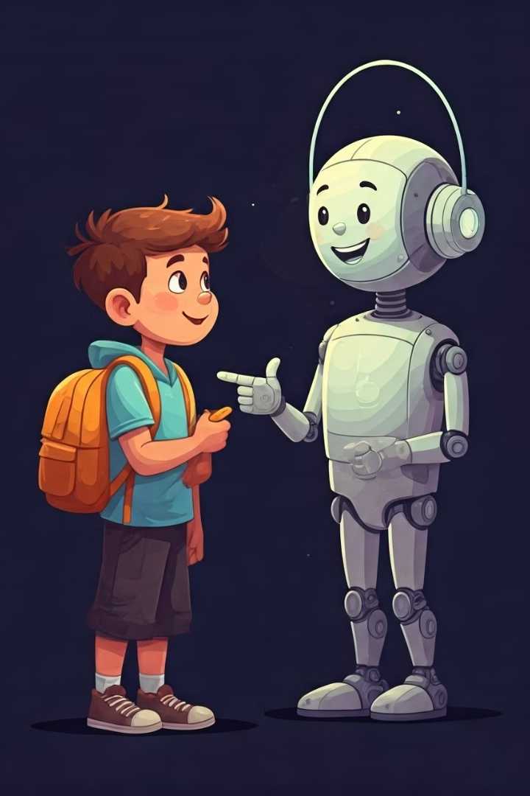



AI-Powered Support by Serena
Answering Questions
Serena is always available to clarify concepts, answer questions, and provide instant feedback.
Personalized Guidance
Serena's AI-powered insights help students overcome roadblocks and stay motivated throughout their learning journey.
Progress Tracking
Serena monitors students' progress, celebrates their achievements, and provides personalized recommendations for improvement.

Slide 6

Motivation Through Gamification
Coding Challenges
Achievements
Leaderboards
Interactive coding challenges and mini-games keep students engaged and help them apply their knowledge in a fun, rewarding way.
Students earn points, badges, and other rewards for completing lessons, solving problems, and reaching milestones in their learning journey.
Friendly competition and leaderboards encourage students to stay motivated and continuously improve their coding skills.

Slide 7
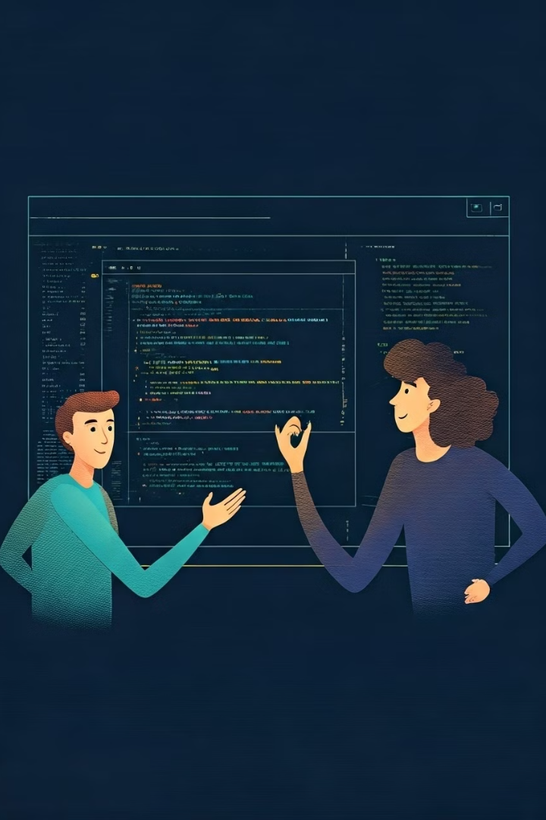



Interactive Problem-Solving
Code Editor
Our integrated code editor allows students to write, test, and debug their code in real-time.
Live Collaboration
Students can work together on coding challenges, sharing their screens and ideas to solve problems collaboratively.
Immediate Feedback
Our AI-powered assistant provides instant feedback, helping students identify and fix errors in their code.

Slide 8

Personalized Feedback on Learning
Skill Progress Strengths and Weaknesses Recommended Next Steps Detailed tracking of a student's mastery of key programming concepts and skills.
Identification of a student's strongest and weakest areas, guiding personalized interventions.
Tailored recommendations for the student's next learning activities based on their performance.

Slide 9
Technologies Powering Teacher.io
Frontend
Backend
AI & Analytics
React and JavaScript provide a seamless, responsive, and engaging user experience for our online learning platform.
Our robust backend, built with Node.js and Express, powers the API and data management for the platform.
Machine learning algorithms and data analytics capabilities drive the personalization, feedback, and insights that power the platform.

Slide 10

Next Steps
Ready to embark on your programming journey? Sign up for Teacher.io today and let Serena be your guide. Start exploring our interactive lessons, challenge yourself with coding exercises, and unlock the power of personalized learning. As you progress, Serena will track your achievements, identify your strengths and areas for improvement, and recommend tailored next steps to keep you motivated and moving forward. Together, let's unlock your coding potential with Teacher.io!

Slide 11

What’s Next for Teacher.io?
Expanding Gamification: Introducing new interactive challenges, levels, and achievement badges to keep learners motivated and engaged.
Enhanced AI Capabilities: Improving Serena AI to offer deeper explanations, personalized hints, and more interactive debugging sessions.
Collaborative Learning: Enabling peer-to-peer coding sessions, group projects, and community-based learning to foster a supportive environment.
Adaptive Assessments: Developing AI-driven adaptive tests that adjust in difficulty based on user progress, ensuring learners stay challenged.
Personalized Learning Recommendations: Leveraging AI to provide custom learning suggestions based on individual strengths, weaknesses, and goals.

Slide 12
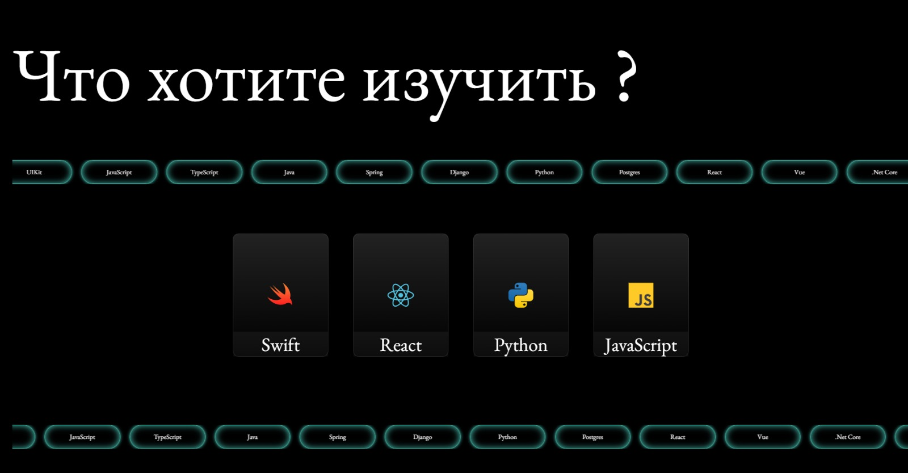

Current view

Slide 13
Thanks for your attention!!!

